Slide 1
HTML5 API
by Ihor Dubas

Slide 2
API
Application Programming Interfaces (APIs) are pre-built programming language constructs that allow the developer to build complex functionality with less effort. They "hide" more complex code from the programmer, providing ease of use.

Slide 3
Most popular HTML5 API
Geolocation
Drag and Drop
Web storage
Web workers
SSE

Slide 4
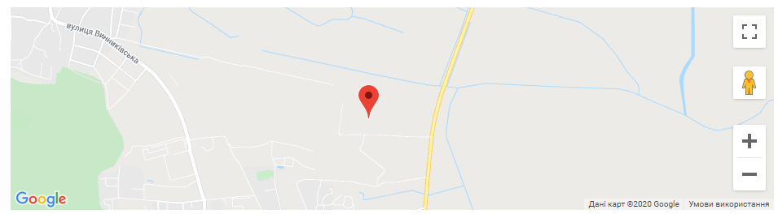
Geolocation API
The HTML Geolocation API is used to locate a user's position.
The HTML Geolocation API is used to get the geographical position of a user. Since this can compromise privacy, the position is not available unless the user approves it.
Geolocation is most accurate for devices with GPS, like smartphone.

Slide 5
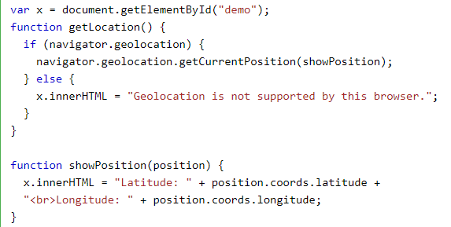
Using HTML Geolocation
The getCurrentPosition() method is used to return the user's position.
The example below returns the latitude and longitude of the user's position:

Slide 6
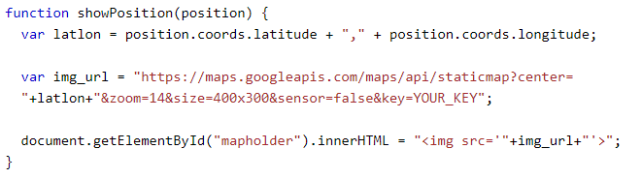
Displaying the result in a map
To display the result in a map, you need access to a map service, like Google Maps.
In the example below, the returned latitude and longitude is used to show the location in a Google Map (using a static image):

Slide 7
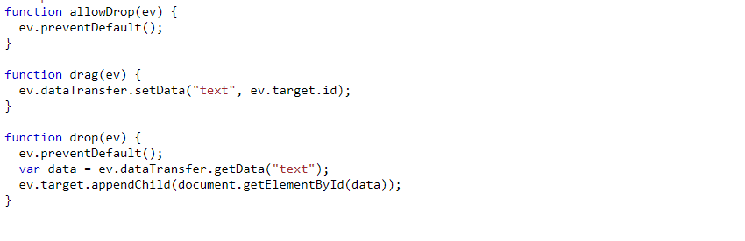
Drag and Drop API
In HTML, any element can be dragged and dropped.
Drag and drop is a very common feature. It is when you "grab" an object and drag it to a different location.

Slide 8
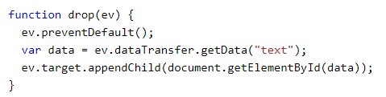
Do the Drop - ondrop
When the dragged data is dropped, a drop event occurs.
In the example above, the ondrop attribute calls a function, drop(event):

Slide 9
Web Storage API
With web storage, web applications can store data locally within the user's browser.
Before HTML5, application data had to be stored in cookies, included in every server request. Web storage is more secure, and large amounts of data can be stored locally.
Unlike cookies, the storage limit is far larger (at least 5MB) and information is never transferred to the server.

Slide 10
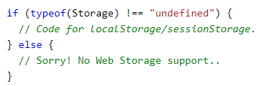
Web Storage Objects
HTML web storage provides two objects for storing data on the client:
window.localStorage - stores data with no expiration date
window.sessionStorage - stores data for one session (data is lost when the browser tab is closed)
Before using web storage, check browser support for localStorage and sessionStorage:

Slide 11
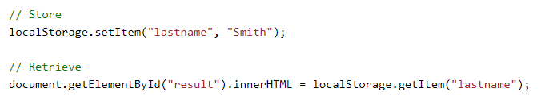
localStorage object
The localStorage object stores the data with no expiration date. The data will not be deleted when the browser is closed, and will be available the next day, week, or year.
Note: Name/value pairs are always stored as strings. Remember to convert them to another format when needed!

Slide 12
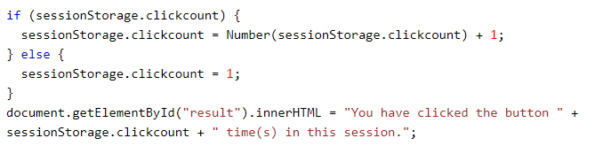
sessionStorage object
The sessionStorage object is equal to the localStorage object, except that it stores the data for only one session. The data is deleted when the user closes the specific browser tab.
The following example counts the number of times a user has clicked a button, in the current session:

Slide 13
Web Workers API
A web worker is a JavaScript running in the background, without affecting the performance of the page.
When executing scripts in an HTML page, the page becomes unresponsive until the script is finished.
A web worker is a JavaScript that runs in the background, independently of other scripts, without affecting the performance of the page.

Slide 14
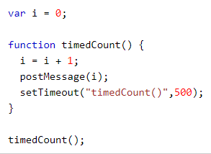
Web Worker File
Example of a script that counts.
The important part of the code above is the postMessage() method - which is used to post a message back to the HTML page. The script is stored in the "demo_workers.js" file
Note: Normally web workers are not used for such simple scripts, but for more CPU intensive tasks.

Slide 15


Create a Web Worker Object
The following lines checks if the worker already exists, if not - it creates a new web worker object and runs the code in "demo_workers.js":
Add an "onmessage" event listener to the web worker.

Slide 16


To terminate a web worker, and free browser/computer resources, use the terminate() method:
If you set the worker variable to undefined, after it has been terminated, you can reuse the code:

Slide 17
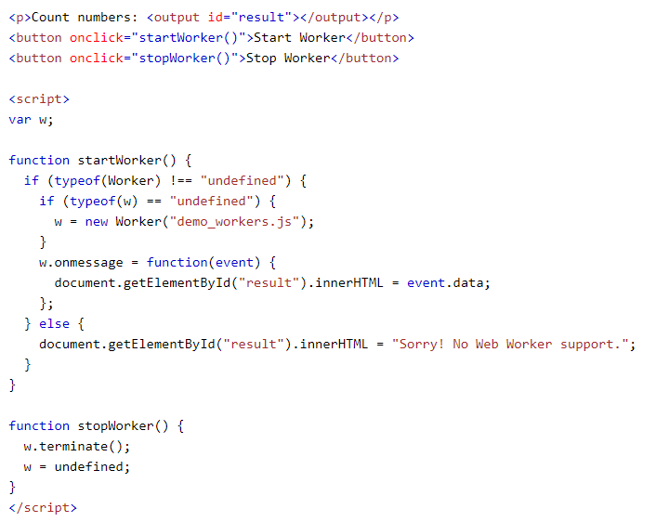

Slide 18
Web Workers and the DOM
Since web workers are in external files, they do not have access to the following JavaScript objects:
The window object
The document object
The parent object

Slide 19
SSE API
Server-Sent Events (SSE) allow a web page to get updates from a server.
A server-sent event is when a web page automatically gets updates from a server.
This was also possible before, but the web page would have to ask if any updates were available. With server-sent events, the updates come automatically.
Examples: Facebook/Twitter updates, stock price updates, news feeds, sport results, etc.

Slide 20

The Server-Sent Events specification describes the built-in EventSource class, which allows you to maintain a connection to the server and receive events from it.
It provides:
Auto reconnect with custom retry delay.
Message IDs to reconnect. The last identifier received is sent in the Last-Event-ID header when reconnecting.
The current state recorded in the readyState property.
The second argument is an optional object with one property: {withCredentials: true}. It allows you to send authorization data to other domains.

Slide 21
Server response format
The server sends messages separated by double line breaks \ n \ n.
The message consists of the following fields:
data: - message body, several data in a row are interpreted as one message, separated by line breaks \ n.
id: - updates the lastEventId property that is sent to Last-Event-ID when reconnecting.
retry: - recommended delay before reconnection in milliseconds. Cannot be installed using JavaScript.
event: - the name of the user event, must be specified before data :.
A message may include one or more of these fields in any order, but id is usually put at the end.

Slide 22


